Slide 1



Transitional Safeguarding
Dez Holmes
Director, Research in Practice
@dez_holmes

Slide 2
What Transitional Safeguarding is and why it is needed
‘safeguarding adolescents and young adults fluidly across developmental stages which builds on the best available evidence, learns from both children’s and adult safeguarding practice and which prepares young people for their adult lives’ (Holmes & Smale, 2018)
Reflects evidence that the current binary approach bears significant human and economic costs
Not just transition planning or ‘service transfer’
“early help for grown ups”
Extends beyond statutory duties – holistic, flexible, person-centred
An integrated system of support: social care, health, justice, education… whole place whole person
Safeguarding is a verb, not a noun

Slide 3
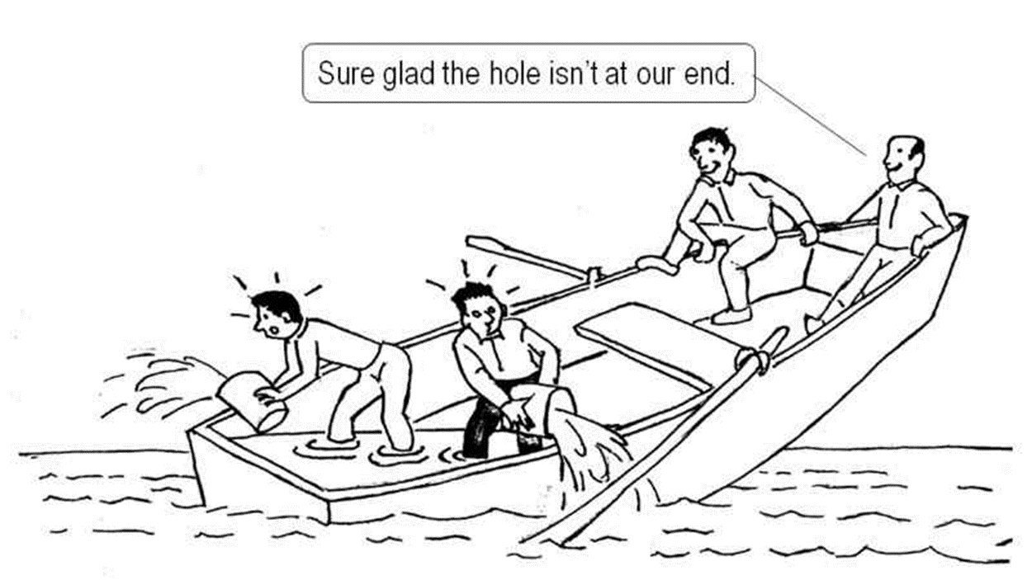
Systems leadership and boundary-spanning
“Systems leadership is… a collective form of leadership, … ‘leadership as participation’ rather than ‘leadership as performance’, and …. Systems leadership crosses boundaries, both physical and virtual, existing simultaneously in multiple dimensions. It therefore extends individual leaders well beyond the usual limits of their formal responsibilities and authority.” (Ghate et al, 2013)
Transitional Safeguarding is the connective tissue… ‘a movement not another project’

Slide 4
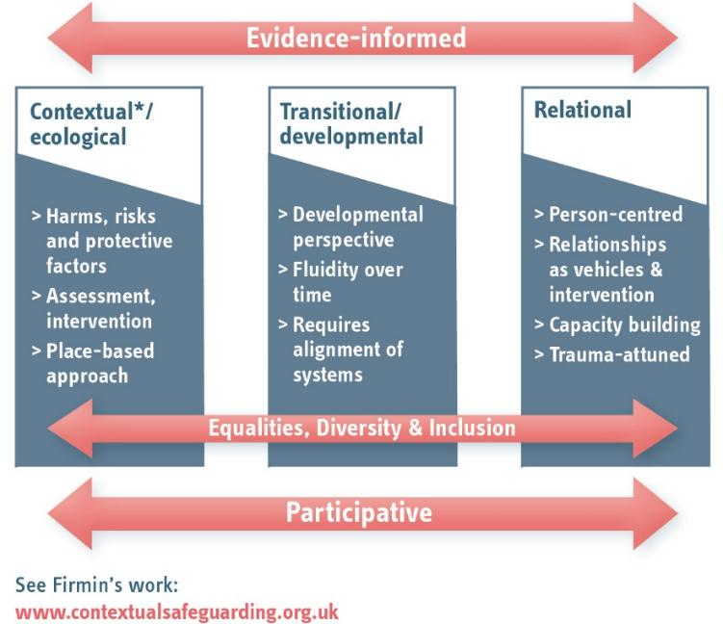
Key principles (Holmes, 2018)

Slide 5

*Contact details/process information –
*Individual agencies to rewrite this section and add in their specific processes, links etc…
*Picture added for colour as a reference, feel free to remove or replace
5

