Slide 1

Safeguarding Adults: An Introduction
Notes:
1

Slide 2

Learning Outcomes:
At the end of this presentation you should:
Have an overview of eligibility criteria for Adult Social Care and how that links to Adult Safeguarding
You will be able to:
Understand what adult safeguarding and abuse is
Recognise types of adult abuse
You will know how to:
Make an adult safeguarding referral to Nottingham City Council’s Adult Social Care (ASC) Department

Slide 3
2014 Care Act eligibility for Adult Social Care:
An adult’s needs meet the eligibility criteria if…
The adult’s needs arise from or are related to a physical or mental impairment or illness
As a result of the adult’s needs the adult is unable to achieve two or more of the outcomes specified (see column 2 of next slide) and
As a consequence there is, or is likely to be, a significant impact on the adult’s well-being

Slide 4
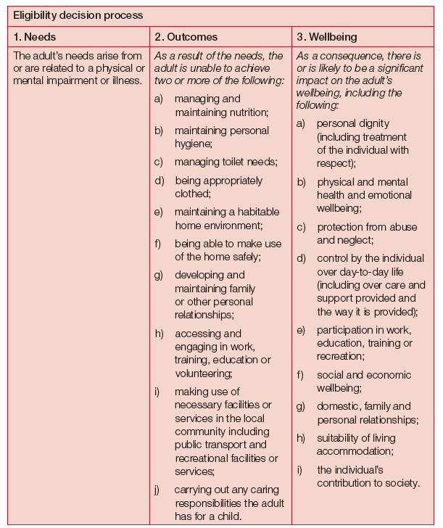

Slide 5
Local Authority Adult Safeguarding Duties:
The Care Act 2014 sets out Local Authority Adult Safeguarding Duties:
A Local Authority must make enquiries, or ensure others do so, if it believes an adult is subject to, or at risk of, abuse or neglect. An enquiry should establish whether any action needs to be taken to stop or prevent abuse or neglect, and if so, by whom

Slide 6
Safeguarding Responsibilities 1:
Safeguarding duties apply to an adult who:
Has need for care and support (whether or not the local authority is meeting any of those needs) AND;
Is experiencing, or at risk of, abuse or neglect; AND
As a result of those care and support needs is unable to protect themselves from either the risk of, or the experience of abuse and neglect

Slide 7
Safeguarding Responsibilities 2:
The eligibility criteria for Adult Social Care (as defined by the Care Act 2014) means not all adults experiencing abuse will have a need for care and support (slides 3 and 4). Therefore, they will not meet the criteria for adult safeguarding (slide 6)
However, in those circumstances another type of referral may be more appropriate to another agency, e.g. Police, Women’s Aid etc.
If you are unsure or would like further advice please contact Nottingham City Health & Care Point (NCHP: see slide 21)

Slide 8
Types of abuse defined by the Care Act 2014:
Physical
Domestic violence
Sexual
Psychological
Financial
Modern slavery
Discriminatory
Organisational (Previously institutional)
Neglect / Acts of omission
Self neglect

Slide 9
Physical Abuse:
Including…
Assault
Hitting
Slapping
Pushing
Misuse of medication
Restraint
Inappropriate physical sanctions
Notes:
9

Slide 10
Domestic Violence:
Including…
Psychological
Physical
Sexual
Financial
Emotional abuse
So called ‘honour 'based violence
Notes:
10

Slide 11
Sexual Abuse:
Including…Rape
Indecent exposure
Sexual harassment
Inappropriate looking or touching
Sexual teasing or innuendo
Sexual photography
Subjection to pornography or witnessing sexual acts
Indecent exposure
Sexual assault
Sexual acts to which the adult has not consented or was pressured into
Notes:
11

Slide 12
Psychological Abuse:
Including emotional abuse, threats of harm or abandonment, deprivation of contact, humiliation, blaming, controlling, intimidation, coercion, harassment, verbal abuse, cyber bullying, isolation or unreasonable and unjustified withdrawal of services or supportive networks
Notes:
12

Slide 13
Financial or Material Abuse:
Including…Theft
Fraud
Internet scamming
Coercion in relation to an adult’s financial affairs or arrangements, including in connection with wills, property or inheritance or financial transactions
The misuse or misappropriation of property, possessions or benefits
Notes:
13

Slide 14
Modern Slavery:
Encompassing…Slavery
Human trafficking
Forced labour and domestic servitude.
Traffickers and slave masters using whatever means they have at their disposal to coerce, deceive and force individuals into a life of abuse, servitude and inhumane treatment
Notes:
14

Slide 15
Discriminatory Abuse:
Including…Harassment
Slurs or similar treatment because of:
Race
Gender and gender identity
Age
Disability
Sexual orientation
Religion
Notes:
15

Slide 16
Organisational Abuse:
Including neglect and poor care practice within an institution or specific care setting such as a hospital or care home, or in relation to care provided in one’s own home. This may range from one off incidents to on-going ill-treatment. It can be through neglect or poor professional practice as a result of the structure, policies, processes and practices within an organisation
Notes:
16

Slide 17
Neglect and Acts of Omission:
Including…ignoring medical, emotional or physical care needs
Failure to provide access to appropriate health, care and support or educational services
The withholding of the necessities of life, such as medication, adequate nutrition and heating
Notes:
17

Slide 18
Self-Neglect:
This covers a wide range of behaviour including neglecting to care for one’s personal hygiene, health or surroundings and includes behaviour such as hoarding
Notes:
18

Slide 19
Before making a Safeguarding Referral:
If the adult at risk is in imminent danger or you suspect a crime has been committed contact the Police on 999
If the adult at risk has any injury seek appropriate medical attention
If the safeguarding incident occurred in another Local Authority (LA) area then refer to that LA
If the concern relates to the quality of care provided by a nursing or residential home or home care agency, but does not meet the safeguarding criteria, contact the Care Quality Commission:
CQC National Customer Service Centre, Citygate, Gallowgate, Newcastle upon Tyne, NE1 4PA, Tel: 03000 616161, Fax: 03000 616171

Slide 20
Before making a Safeguarding Referral 2:
Many organisations have a designated Safeguarding Lead. You may wish to seek advice and discuss concerns with them in the first instance
If you think a manager in your organisation might be implicated in the abuse of an adult you should discuss your concerns with a more senior colleague or refer to Nottingham City Council Adult Social Care for advice. Your organisation may have a ‘whistle-blowing’ policy you can refer to
It is a good idea to keep a written record of conversations that can be referenced when you make a safeguarding referral

Slide 21
Consent and Referrals
If possible try to get consent from the adult at risk before making an adult safeguarding referral to Adult Social Care
You can make a referral without consent, please contact Adult Social Care to discuss

Slide 22
Making a Safeguarding Referral:
Safeguarding is everyone's responsibility. If you have concerns, please make a referral to Nottingham City Council’s Adult Social Care Department to discuss them:
Phone
Call Nottingham Health and Care Point – 0115 876 3330
Or access the hub:
Adult Social Care Hub
Outside of these hours if you have a social care need that requires an immediate response, please call the Emergency Duty Team on 0115 8761000

Slide 23
Safeguarding Training
This slideshow is not a substitute for training. Any training commissioned should explain:
What safeguarding is – and is not
Its statutory basis, with reference to the Care Act & other legislation
How to identify abuse
What to do when abuse is identified, including alerting others and referring to the LA
The need to involve others & make people safe
What happens when a referral is made, including enquiries & investigations
Confidentiality & working without consent
Use of the Mental Capacity Act
Whistleblowing & allegations against staff
The importance of record keeping & organisational policies
Making Safeguarding Personal & Anti-discriminatory practice

